Slide 1
Data lab 1
EE502 Statistics and Study Designs
Starting 12:15
If you have had trouble downloading R, please let me know ☺

Slide 2
Me
Sannija Goleva-Fjellet (sannija.goleva-fjellet@usn.no, )
Associate professor at INHM
Molecular biologist: exercise genetics & ecology
NOT statistician, got some basic training (less than Jan with statistics but more with rstudio)
I can answer some of your questions!
We can also ask Jan or others at the institute

Slide 3
Me
Peter Groth Farsund (peter@bioner.bio)
Data analyst at Bionér AS
Molecular ecologist, soil biology
Not statistician, got some basic training (less than Jan and Sannija with statistics but more with rstudio)
I can answer some of your questions!
We can also ask Jan or others at the institute

Slide 4
The data labs
Repetition of lectures
Get familiar with R software
Learn how to do statistics in R(studio)
Some hand calculations of statistics?

Slide 5
EXCEL
You will also need Excel
Download from USN server (for free!)

Slide 6
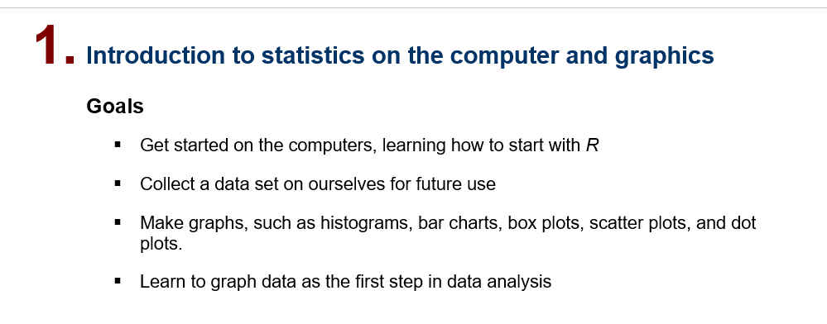
The lab manuals: Goals

Slide 7
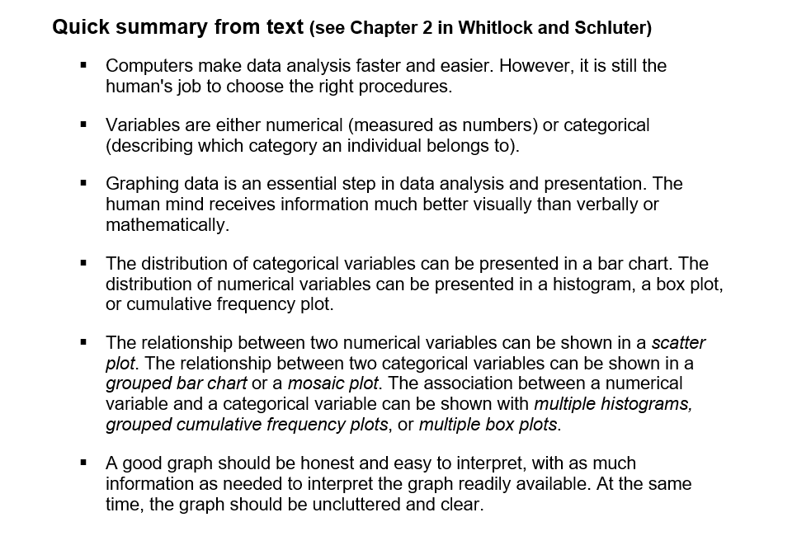
The lab manuals: Summary

Slide 8
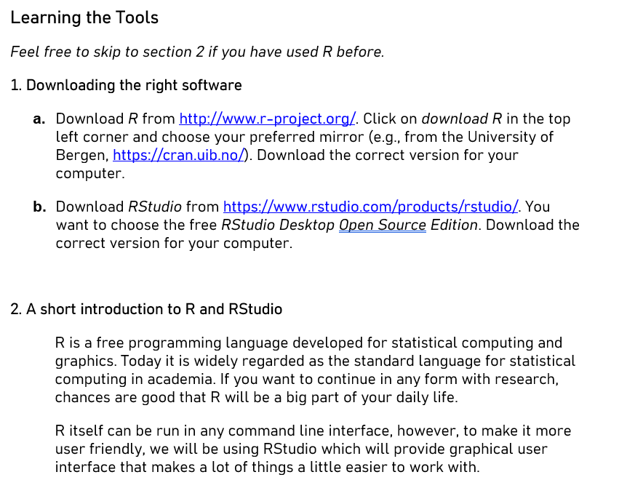
The lab manuals: Learning the tools
We go through this together:
The functions you will need to work with today’s topic

Slide 9
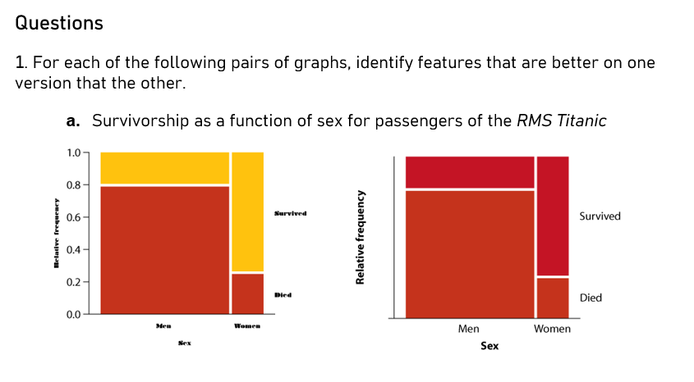
The lab manuals: Questions
This lab: seven questions

Slide 10
Today
We go through the whole «learning the tools» part together
We will have some time for helping people getting along (but of course not endless)

Slide 11
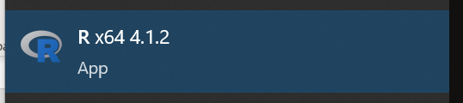
R
Hope you managed to download R?
R is a really good (and widely used!) tool for doing data cleaning, statistics, visualising etc.
But: for many of you: new software?
Need to learn new ‘language’, etc.

Slide 12
Student data set 2023
https://forms.gle/SuzKq5GCeC7LV9PbA
Fill out the form
I will upload the dataset to canvas
Then you can use it in R

